Slide 1
Topic: Linear inequalities
EQ: How to graph linear inequalities?

Slide 2
24
7
30
Topic: Linear Inequalities
Date
EQ – How to solve linear inequalities?
Graphing a linear inequality is very similar to graphing a linear equation.
1) Solve the inequality for y
(or for x if there is no y).
2) Change the inequality to an equation
and graph.
3) If the inequality is < or >, the line
is dotted. If the inequality is ≤ or
≥, the line is solid.
What is an inequality?

Slide 3
24
7
30
Topic: Linear Inequalities
Date
EQ – How to solve linear inequalities?
The basic technique for solving inequality is to:
imagine that in place of the inequality sign, there is an equals sign
solve the inequality as if it were a linear equation, except that in place of the equals sign keep the original inequality sign unless the special case outlined below applies- we will do these examples later
How to solve an inequality?

Slide 4
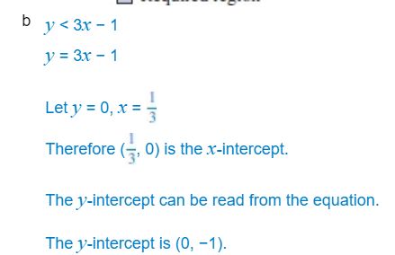
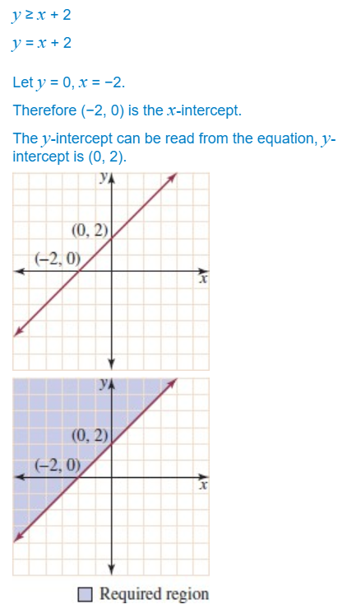
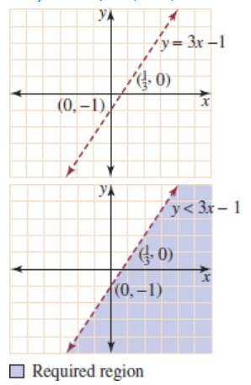
Worked examples: We will do these together
Sketch the half plane given by each of the following inequations.
y ≥ x + 2
y < 3x − 1
Solutions:

Slide 5
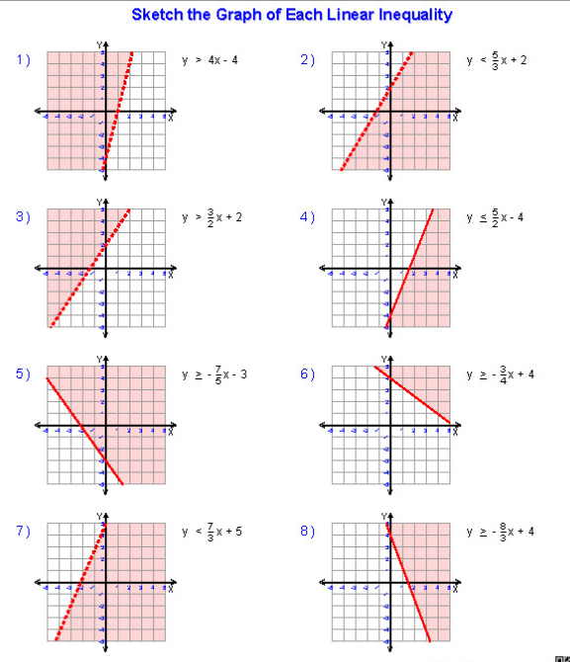

Your turn: Sketch the graph of each of the following linear inequalities
$y>4x−4$
$y< \frac{5}{5}$ $x+2$
$y> \frac{3}{2}$ $x+2$
$y≤ \frac{5}{2}$ $x−4$

